Slide 1
Introduction to Thermodynamics
Principles Of Engineering

Slide 2
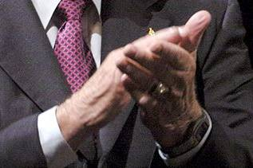
Thermodynamics
Rub your hands together for 15 seconds.
Are your hands warm?
Thermal energy

Slide 3
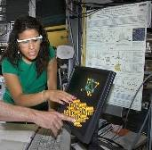
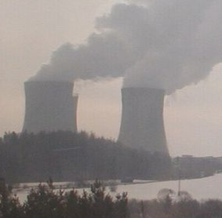
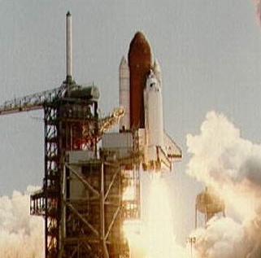
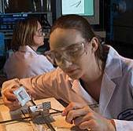
Thermodynamics
The study of the effects of work, heat flow, and energy on a system
Movement of thermal energy
Engineers use thermodynamics in systems ranging from nuclear power plants to electrical components.
SURROUNDINGS
SYSTEM
BOUNDARY
Notes:
Thermodynamics is the study of the effects of work, heat, and energy on a system. Put another way: nothing happens without heat flow.
What is a thermodynamic system? A thermodynamic system is a part of the physical world as described by its thermodynamic properties such as temperature, volume, pressure, concentration, surface tension, and viscosity.

Slide 4
Thermal Energy versus Temperature
Thermal Energy is kinetic energy in transit from one object to another due to temperature difference. (Joules)
Temperature is the average kinetic energy of particles in an object – not the total amount of kinetic energy particles. (Degrees)
Temperature #1
Temperature #2
Heat
Notes:
If a 100 gram mass is at the same temperature as a 200 gram mass, the average kinetic energy of the particles in both masses is the same. However, the total amount of kinetic energy in the 200 gram mass is twice the amount in the 100 gram mass.

Slide 5
Temperature Scales
Scale | Freezing point of water | Boiling point of water
Celsius | 0°C | 100°C
Fahrenheit | 32°F | 212°F
Kelvin | 273K | 373K
Matter is made up of molecules in motion (kinetic energy)
An increase in temperature increases motion
A decrease in temperature decreases motion
Absolute Zero occurs when all kinetic energy is removed from a object 0 K = -273° C

Slide 6
Thermodynamic Equilibrium
Thermal equilibrium is obtained when touching objects within a system reach the same temperature.
When thermal equilibrium is reached, the system loses its ability to do work.
Zeroth Law of Thermodynamics: If two systems are separately found to be in thermal equilibrium with a third system, the first two systems are in thermal equilibrium with each other.
Object #1
(Thermometer)
Object #1
Object #2
Object #2
Object #3
Notes:
Zeroth Law (Thermodynamic Equilibrium): The law states that if two systems are separately found to be in thermal equilibrium with a third system, the first two systems are in thermal equilibrium with each other; that is, all three systems are at the same temperature.
Put another way: There is not heat flow between objects if those objects have the same temperature.

Slide 7
Thermal Energy (heat) Transfer
The transfer or movement of thermal energy
Most common types of transfer
Convection
Conduction
Radiation
100% efficiency is unattainable
ALL processes are irreversible
Notes:
Radiation: The process by which energy is transmitted through a medium, including empty space, as electromagnetic waves. This energy travels at the speed of light. This is also referred to as electromagnetic radiation (EM radiation). One of the most common examples of this is the heat transferred from the Sun to the Earth.
Convection: Process by which, in a fluid being heated, the warmer part of the mass will rise and the cooler portion will sink. If the heat source is stationary, convection cells may develop as the rising warm fluid cools and sinks in regions on either side of the axis of rising. Put another way: Convection is the transfer of heat energy occurring by a movement of currents; this typically occurs in a gas or liquid state.
Conduction: The transfer of heat within an object or between objects by molecular activity, without any net external motion. This transfer of heat works better in solids than liquids. Put another way: Conduction is the transfer of heat by the movement of warm matter. For example, a metal spoon placed in a hot cup of soup will feel warm to your hand because the heat from the soup is conducted through the spoon.

Slide 8
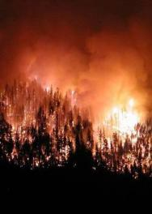
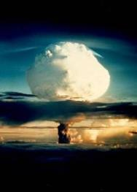
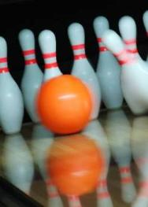
1st Law of Thermodynamics
Law of energy conservation applied to a thermal system
Thermal energy can change form and location, but it cannot be created or destroyed.
Thermal energy can be increased within a system by adding thermal energy (heat) or by performing work in a system.
Notes:
First Law of Thermodynamics (Conservation of Energy): The law that heat is a form of energy, and the total amount of energy of all kinds in an isolated system is constant. It is an application of the principle of conservation of energy.

Slide 9
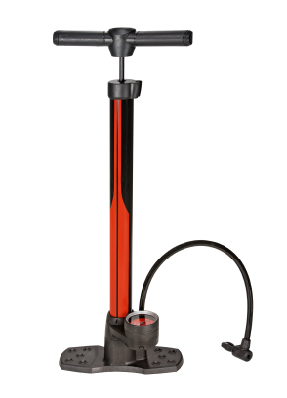
1st Law of Thermodynamics
Example: Using a bicycle pump
Pumping the handle results in what?
Applying mechanical energy into the system
Mechanical energy is converted into thermal energy through friction (the pump becomes hot)
The total increase in internal energy of the system is equal to what?
The applied mechanical energy
©iStockphoto.com

Slide 10
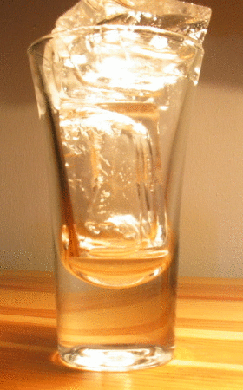
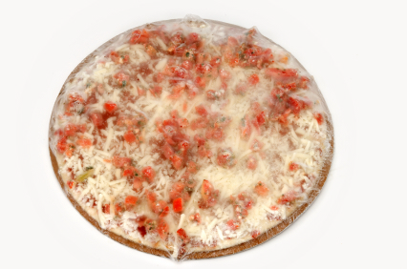
2nd Law of Thermodynamics
Thermal energy flows from hot to cold
When you touch a frozen pizza with your hand, thermal energy flows in what direction?
Hand → Pizza
©iStockphoto.com
When you touch a cooked pizza with your hand, thermal energy flows in what direction?
Pizza → Hand
©iStockphoto.com

Slide 11
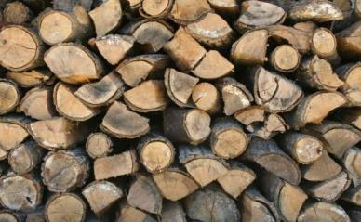
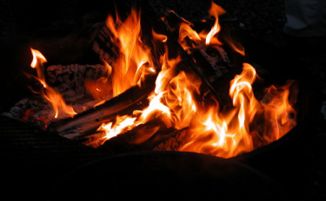
2nd Law of Thermodynamics
Entropy is the measure of how evenly distributed heat is within a system.
- A system tends to go from order to disorder
Order
Disorder
Firewood has low entropy (molecules in order) when stacked and high entropy when burning (molecules in disorder).
The total amount of energy in the world does not change, but the availability of that energy constantly decreases.
Notes:
A general statement of the idea that there is a preferred direction for any process. This law deals with the variable called entropy: the function of the state of a thermodynamic system whose change in any differential reversible process is equal to the heat absorbed by the system from its surroundings divided by the absolute temperature of the system. Put another way: Entropy is a measure of how evenly distributed heat is within a system.

Slide 12
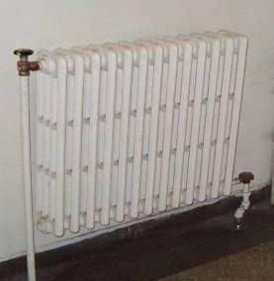
Thermal Energy Transfer
Convection The transfer of thermal energy by movement of fluid (liquid or gas)
When fluid is heated, it expands, becomes less dense, and rises.
Boiler heating systems circulate heat throughout a home without pumps through the use of convection.
Notes:
Convection: Process by which, in a fluid being heated, the warmer part of the mass will rise and the cooler portion will sink. If the heat source is stationary, convection cells may develop as the rising warm fluid cools and sinks in regions on either side of the axis of rising.
Put another way: Convection is the transfer of heat energy occurring by a movement of currents; this typically occurs in a gas or liquid state.

Slide 13
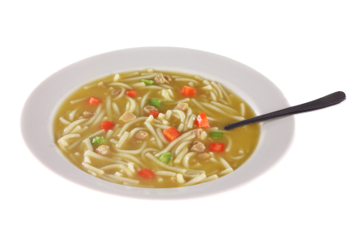
Thermal Energy Transfer
Conduction The transfer of thermal energy within an object or between objects from molecule to molecule
A metal spoon placed in a hot cup of soup will feel warm to your hand. The heat from the soup is conducted through the spoon.
©iStockphoto.com
Notes:
Conduction: The transfer of heat within an object or between objects by molecular activity, without any net external motion. This transfer of heat works better in solids than liquids. Put another way: Conduction is the transfer of heat by the movement of warm matter. For example, a metal spoon placed in a hot cup of soup will feel warm to your hand because the heat from the soup is conducted through the spoon.

Slide 14
Thermal Energy Transfer Equations

Slide 15
Thermal Energy Transfer Equations

Slide 16
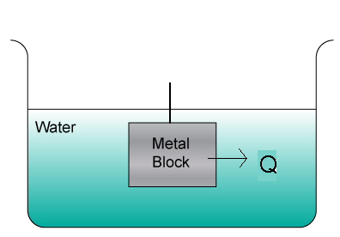
Calculating Energy Transfer
Calculate the energy transferred when a block of aluminum at 80.0°C is placed in 1.00 liter (1kg) of water at 25.0°C if the final temperature becomes 30.0°C.
Q
Step 1. List all known values
Mass of water = m_{water} =
1 kg
Specific heat capacity of water = c_{w}=
4184
change in temperature =
ΔT_{water} = 30.0°C – 25.0°C = 5.0°C
c_{Al} =
900.
change in temperature =
ΔT_{Al} = 80.0°C – 30.0°C = 50.0°C

Slide 17
Calculating Energy Transfer
Step 2. List all unknown values
Q = energy transferred
m_{Al} = mass of the Al block
Step 3. Select equations to solve unknown values
Step 4. Solve for Q_{water}

Slide 18
Calculating Energy Transfer
Step 5. Solve for m_{Al}

Slide 19
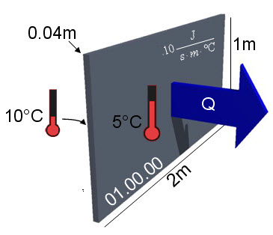
Calculating Energy Transfer
Calculate the energy transfer in a wall section measuring 2m by 1m by 0.04m thick with a thermal conductivity of 0.10 . Opposing sides of the wall section have a temperature of 10°C and 5°C after one hour.
Q
Step 1. List all known values
Area of thermal conductivity =
A = 2m * 1m = 2m²
Thermal conductivity =
k =0.10
Thickness of material =
L = 0.04m
Difference in temperature =
ΔT = 10°C - 5°C = 5°C
Change in time =
Δt = 1 hour = 3600s

Slide 20
Calculating Energy Transfer
Step 2. List all unknown values
P = Rate of energy transfer
Q = Energy transfer
Step 3. Select equations to solve unknown values
Step 4. Solve in terms of Q
Step 5. Combine equations

Slide 21
Calculating Energy Transfer
Step 6. Apply known values

Slide 22
U-Value
Coefficient of Heat Conductivity
The measure of a material’s ability to conduct heat
Metric system
U.S. customary system

Slide 23
R-Value
Thermal Resistance of a Material
The measure of a material’s ability to resist heat
The higher the R-value, the higher the resistance
Bulk R-value =
R-value _{Object 1} + R-value _{Object 2} + … = Total R-Value
Notes:
The R-value is equal to the reciprocal of a material’s U-value.

Slide 24
Calculating R-Value
Determine the R-value of the wall cavity below
1 in. foil-faced polyisocyanurate
(R=7.20)
Fiberglass batt
(R=19)
1 in. air space
(R=0.17)
5/8 in. drywall
(R=0.56)
Brick 2 ¼ x 3 ½ x 8
(R=0.8)
Wall cavity R-value
What is the R-value at a stud location?
0.56
+19.00
+ 7.20
+ 0.17
+ 0.8
0.56
+ 6.88
+ 7.20
+ 0.17
+ 0.8
= 27.7
=15.6
2x6 construction
(2x6 R=6.88)

Slide 25
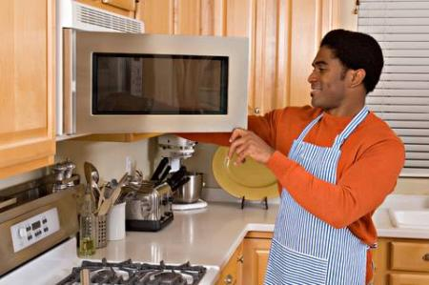
Thermal Energy Transfer
Radiation The process by which energy is transmitted through a medium, including empty space, as electromagnetic waves
Stefan’s Law
All objects lose and gain thermal energy by electromagnetic radiation.
©iStockphoto.com
Electromagnetic waves transfer to food and other matter
Notes:
Radiation: The process by which energy is transmitted through a medium, including empty space, as electromagnetic waves. This energy travels at the speed of light. This is also referred to as electromagnetic radiation (EM radiation). One of the most common examples of this is the heat transferred from the Sun to the Earth.

Slide 26
Thermal Energy Transfer
Prior to dressing for school, a student watches the morning weather to decide what clothes to wear. The bedroom is 65ºF and the student’s skin is 91.4ºF. Determine the net energy transfer from the student’s body during the 15.0 minutes spent watching the morning weather. Note: Skin emissivity is 0.90, and the surface area of the student is 1.30m².
Step 1. List all known values
Area
Emissivity constant
Stefan’s constant
Bedroom temperature
Skin temperature
Change in time
©iStockphoto.com

Slide 27
Thermal Energy Transfer
Step 2. List all unknown values
P = Rate of energy transfer
Q = Energy transfer
©iStockphoto.com
Step 3. Select equations to solve unknown values
Step 4. Apply known values to
Notes:
The equal sign with the dot over it indicates rounding.

Slide 28
Thermal Energy Transfer
Step 4 (continued). Apply known values to
Step 5. Combine equations and solve
©iStockphoto.com
93,500J of energy are transferred from the student’s body during the 15 minutes spent watching the morning weather.

Slide 29
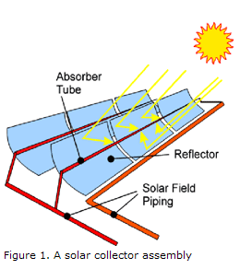
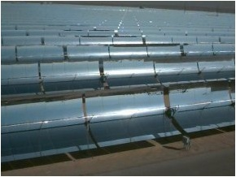
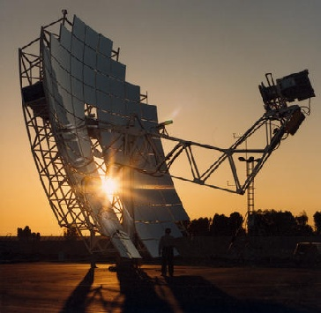
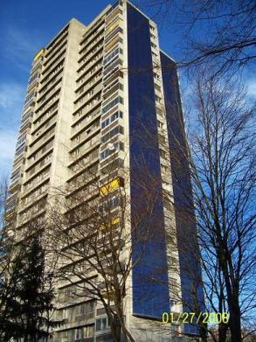
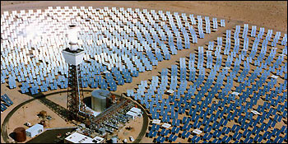
Applications of Thermal Energy
http://www.nrel.gov
Notes:
Solar thermal energy and geothermal energy are just a few applications of thermal energy in general. Solar thermal energy is used to heat water in homes or buildings, swimming pools, and space heating for buildings. Passive thermal energy means that no mechanical equipment is required, much like the interior of a car heating up in the summer. Active thermal energy requires a mechanical device called a heat collector to absorb the heat for circulation purposes.
Some basic types of concentrating heat collectors are:
Parabolic trough: These troughs consist of a heat transfer fluid that circulates throughout the absorber tubes shown above. These tubes then pass the heated fluid to a central location where it is used to generate steam. The steam is transferred to a turbine or generator which uses the steam to produce power or electricity.
Parabolic dish: This dish contains an engine system that converts the collected heat into mechanical power. There is a heat transfer fluid that is a part of the engine system. This fluid is compressed when cold, heated after being compressed, and then processed through a piston which produces a desired work.
Power tower: The mirrors surrounding the tower rotate to continuously focus the sunlight onto a receiving panel at the top of the tower. The receiver panel (appears as a bright light in the image above) contains a fluid inside of it that is used to collect heat from the sunlight.
Photovoltaic (PV) cells: These heat collectors convert sunlight into electricity to run small equipment by creating a direct current (DC). PV cells generate electricity for businesses with an additional step. The grids that collect the DC current from the PV cells must then send the power to inverters to convert the direct current (DC) into an alternating current (AC).

Slide 30
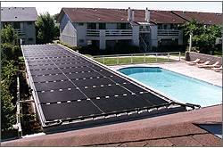
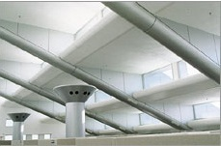
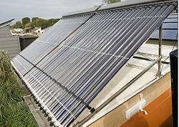
Examples of Solar Energy
All images were obtained from the following URL: http://www1.eere.energy.gov
Notes:
Image #1: This is an example of how a pool is heated in Oregon using solar heat collectors.
Image #2: This is an example of how solar energy can be used to maintain a consistent level of illumination within a room. Lens collectors and reflective light piping is used to control the lighting within a large research facility.
Image #3: This is an example of a school that is using evacuated tubes as a solar water heating collector.
Image #4: This is an example of both active and passive heat collection used in Arizona. This house has large windows facing the south and has a greenhouse, both of which allow for a passive means of warming rooms of the house. This house consists of a rooftop solar water heater and reflective windows that serve as an active means of warming or cooling the house.

Slide 31
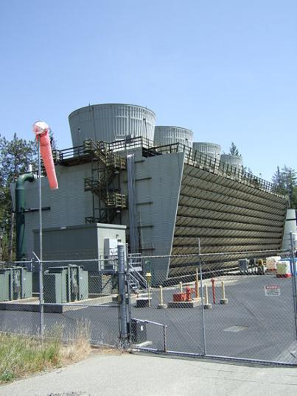
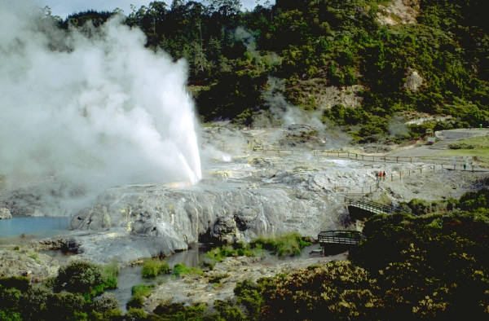
Geothermal Energy
Energy generated from the thermal energy stored beneath the Earth’s surface
Also refers to the heat that is collected from the atmosphere; for instance, near the oceans
Notes:
Geothermal energy refers to the energy generated from the heat that is stored beneath the Earth’s surface. It also refers to the heat that is collected from the atmosphere; for instance, near the oceans.
The United States maintains the largest geyser geothermal plants in the world. The first image is of an ordinary geyser and the second image is of the West Ford Flat Geothermal Cooling Tower. This tower is part of The Geysers, which is the largest geothermal power plant in the world.

Slide 32
Resources
Energy Information Association. (n.d.). Energy kid’s page. Retrieved March 23, 2008, from http://www.eia.doe.gov/kids/energyfacts
McGraw-Hill dictionary of engineering. (2nd ed.). New York, NY: McGraw-Hill.
NASA. (2008). Glenn research center. Retrieved March 23, 2008 from http://www.nasa.gov/centers/glenn/home/index.html
National Renewable Energy Laboratory. (2007). TroughNet. Retrieved March 23, 2008, from http://www.nrel.gov/csp/troughnet
U.S. Department of Energy. (2008). Solar energy technologies program. Retrieved March 23, 2008, from http://www1.eere.energy.gov/solar

