Slide 1
Component Identification: Analog
Introduction to Resistors and Capacitors
Digital Electronics
© 2014 Project Lead The Way, Inc.

Slide 2
Component Identification
This presentation will…
Introduce common components used in electronics.
Define a resistor and present various resistor types and package styles.
Demonstrate how to read a resistor’s nominal value and how to measure its actual value with a Digital Multi-Meter (DMM).
Define a capacitor and present various capacitor types and package styles.
Demonstrate how to read a capacitor’s nominal value.

Slide 3
Resistors
A resistor is an electronic component that resists the flow of electrical current.
A resistor is typically used to control the amount of current that is flowing in a circuit.
Resistance is measured in units of ohms (Ω) and named after George Ohm, whose law (Ohm’s Law) defines the fundamental relationship between voltage, current, and resistance.

Slide 4
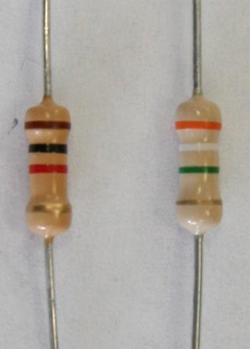
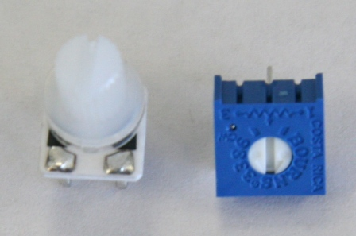
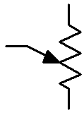
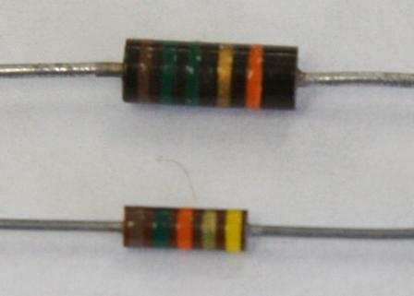
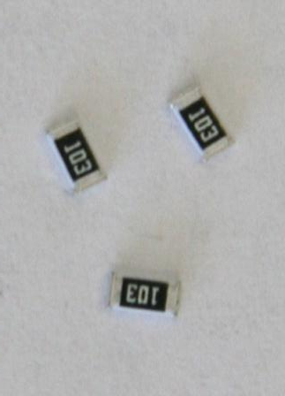
Resistors: Types and Package Styles
Carbon Film Resistors
Variable Resistors
(potentiometer)
4 Bands
Carbon Film Resistors
Surface Mount Resistors
5 Bands

Slide 5
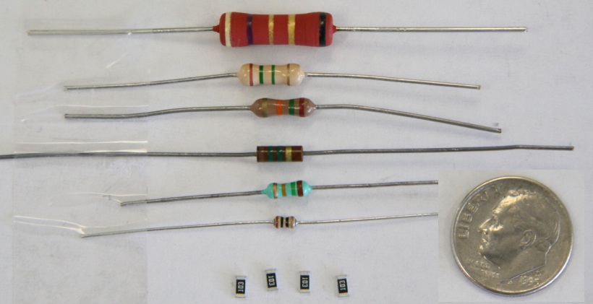
Resistors: Size Comparison

Slide 6
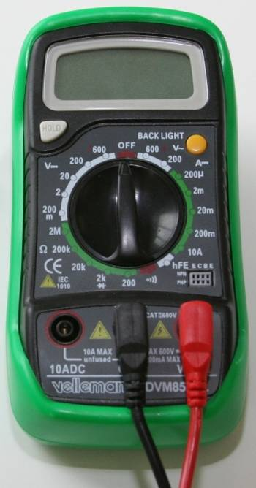
Determining A Resistor’s Value
Color Code
Measured Value
Resistors are labeled with color bands that specify the resistor’s nominal value.
The nominal value is the resistor’s face value.
A Digital Multimeter DMM can be used to measure the resistor’s actual resistance value.

Slide 7
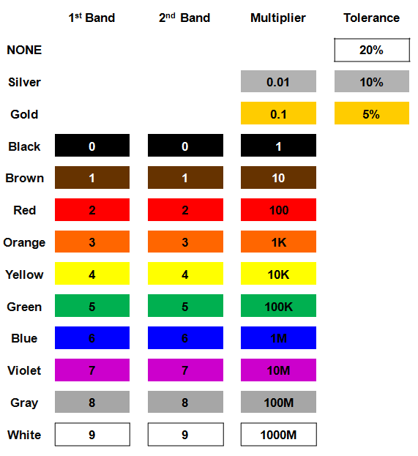
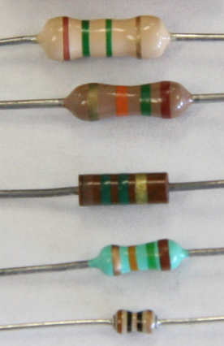
How To Read A Resistor’s Value
Resistor Color Code

Slide 8
Resistor Value: Example #1
Example:
Determine the nominal value for the resistor shown.
1
0
X 100
1000 Ω
1 kΩ

Slide 9
Resistor Value: Example #2
Example:
Determine the nominal value for the resistor shown.
3
0
X 100K
3000 kΩ
3 MΩ

Slide 10
Resistor Value: Example #3
Example:
Determine the color bands for a 1.5 K Ω ±5% resistor.
?
?
?
?
Brown
Green
Red
?
?
?
?

Slide 11
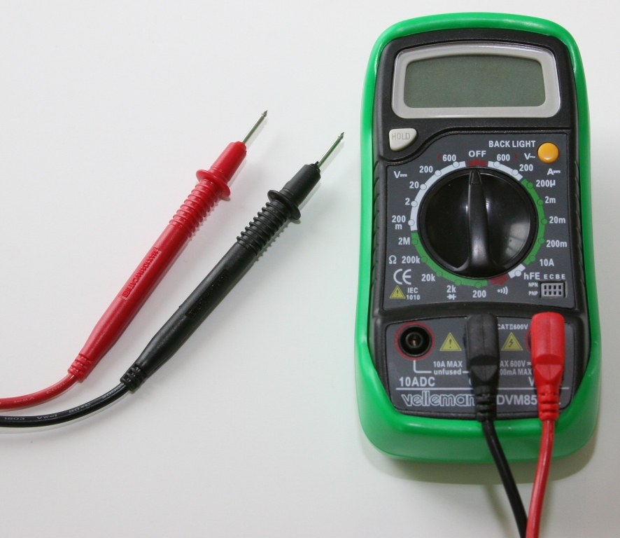
Measured Value
Using a Digital Multi-Meter (DMM) to measure resistance.

Slide 12
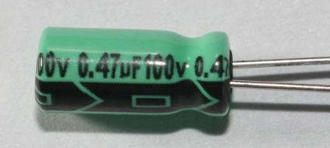
Capacitors
A capacitor is an electronic component that can be used to store an electrical charge.
Capacitors are often used in electronic circuits as temporary energy-storage devices.
Capacitance is measured in units of farads (F) and named after Michael Faraday, a British chemist and physicist who contributed significantly to the study of electromagnetism.

Slide 13
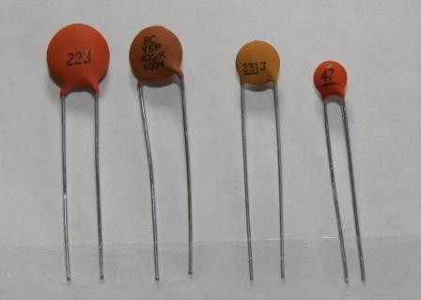
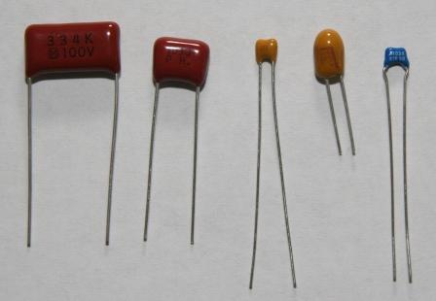
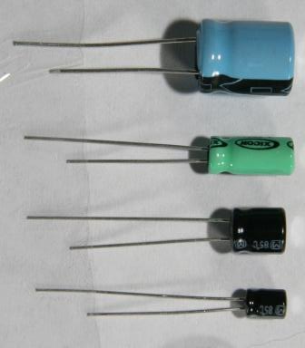
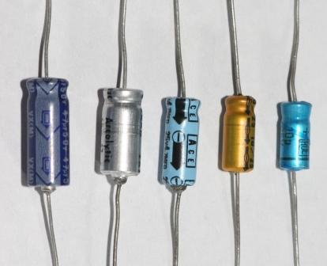
Capacitors: Types and Package Styles
Mylar / Tantalum
Monolithic Ceramic
Ceramic Disc Capacitors
Electrolytic Capacitors
Electrolytic Capacitors
Radial Lead
Axial Lead

Slide 14
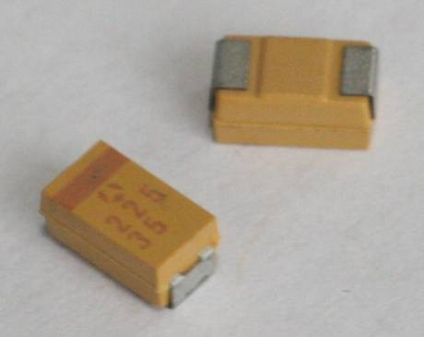
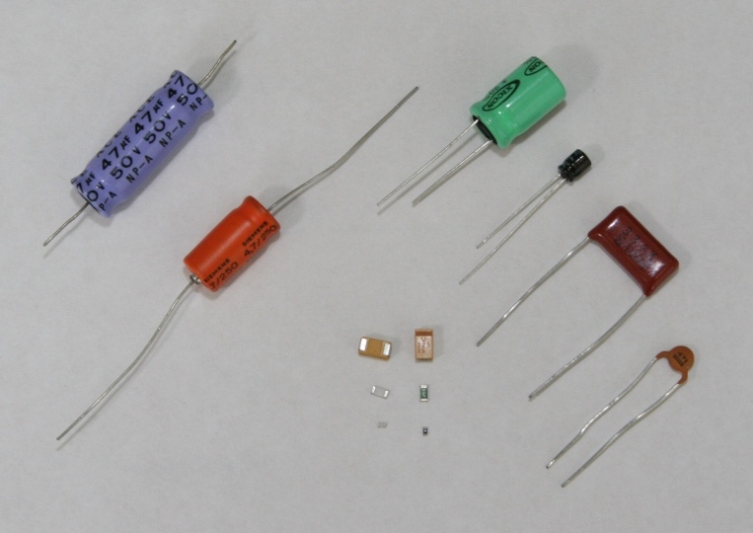
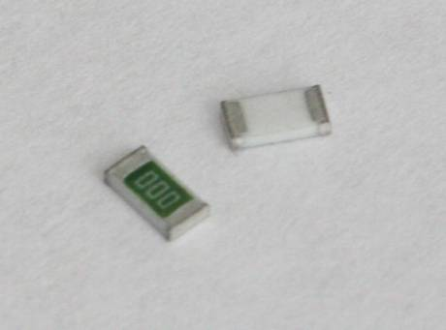
Capacitors: Types and Package Styles
Surface Mount
Tantalum Capacitors
Size Comparison
Surface Mount
Ceramic Capacitors

Slide 15
How To Read A Capacitor’s Value
Electrolytic Capacitors
10 μF +-20%
0.47 μF+-20%

Slide 16
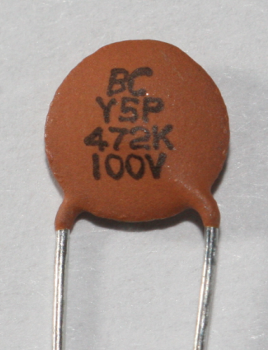
How To Read A Capacitor’s Value
Disc Capacitors
Code | Tolerance
A | ±0.05%
B | ±0.1%
C | ±0.25%
D | ±0.5%
F | ±1%
G | ±2%
J | ±5%
K | ±10%
M or NONE | ±20%
N | ±30%
Q | −10%, +30%
S | −20%, +50%
T | −10%, +50%
Z | −20%, +80%
4
7
2
K
First Digit
Second Digit
Third Digit
Fourth Digit
First Figure
Second Figure
# of Zeros
Tolerance
4
7
00
K
4700 pF ±10%
Note: Units on Disc Capacitors are always in pico-farads

Slide 17
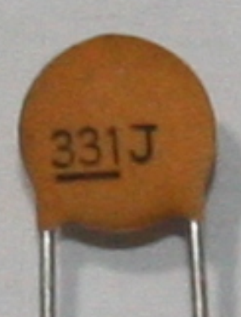
Capacitor: Example #1
Example:
Determine the nominal value for the capacitor shown.
Code | Tolerance
A | ±0.05%
B | ±0.1%
C | ±0.25%
D | ±0.5%
F | ±1%
G | ±2%
J | ±5%
K | ±10%
M or NONE | ±20%
N | ±30%
Q | −10%, +30%
S | −20%, +50%
T | −10%, +50%
Z | −20%, +80%
3
3
0
±5%
330 pF ±5%

Slide 18
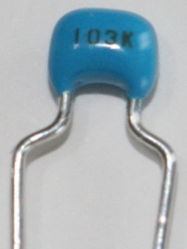
Capacitor: Example #2
Example:
Determine the nominal value for the capacitor shown.
Code | Tolerance
A | ±0.05%
B | ±0.1%
C | ±0.25%
D | ±0.5%
F | ±1%
G | ±2%
J | ±5%
K | ±10%
M or NONE | ±20%
N | ±30%
Q | −10%, +30%
S | −20%, +50%
T | −10%, +50%
Z | −20%, +80%
1
0
000
±10%
10000 pF ±10%

Slide 19
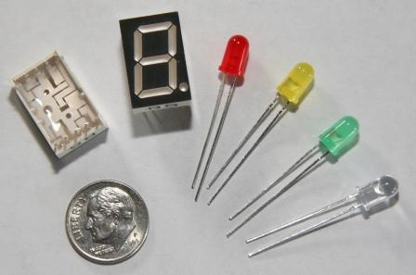
Common Electronic Components Displays
Seven Segment Display
Light Emitting Diodes (LED)
1
2

Slide 20
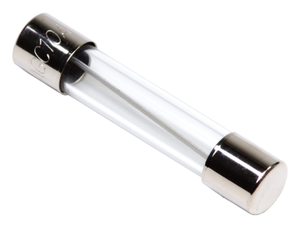
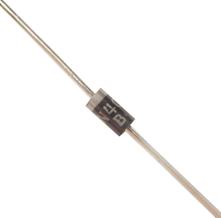
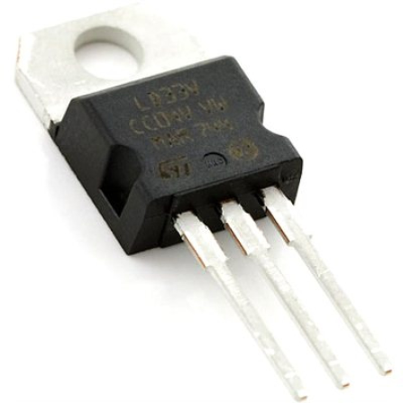
Common Electronic Components Miscellaneous Components
Fuses
Diodes
Voltage Regulator
1
2
3

